Slide 1

ANACONDA Setup
ENGR 1330 - Computational Thinking with Data Science
Instructor: Dr. Theodore Cleveland
Teaching Assistant: Farhang forghanparast
Tuesday Aug 25th, 2020

Slide 2
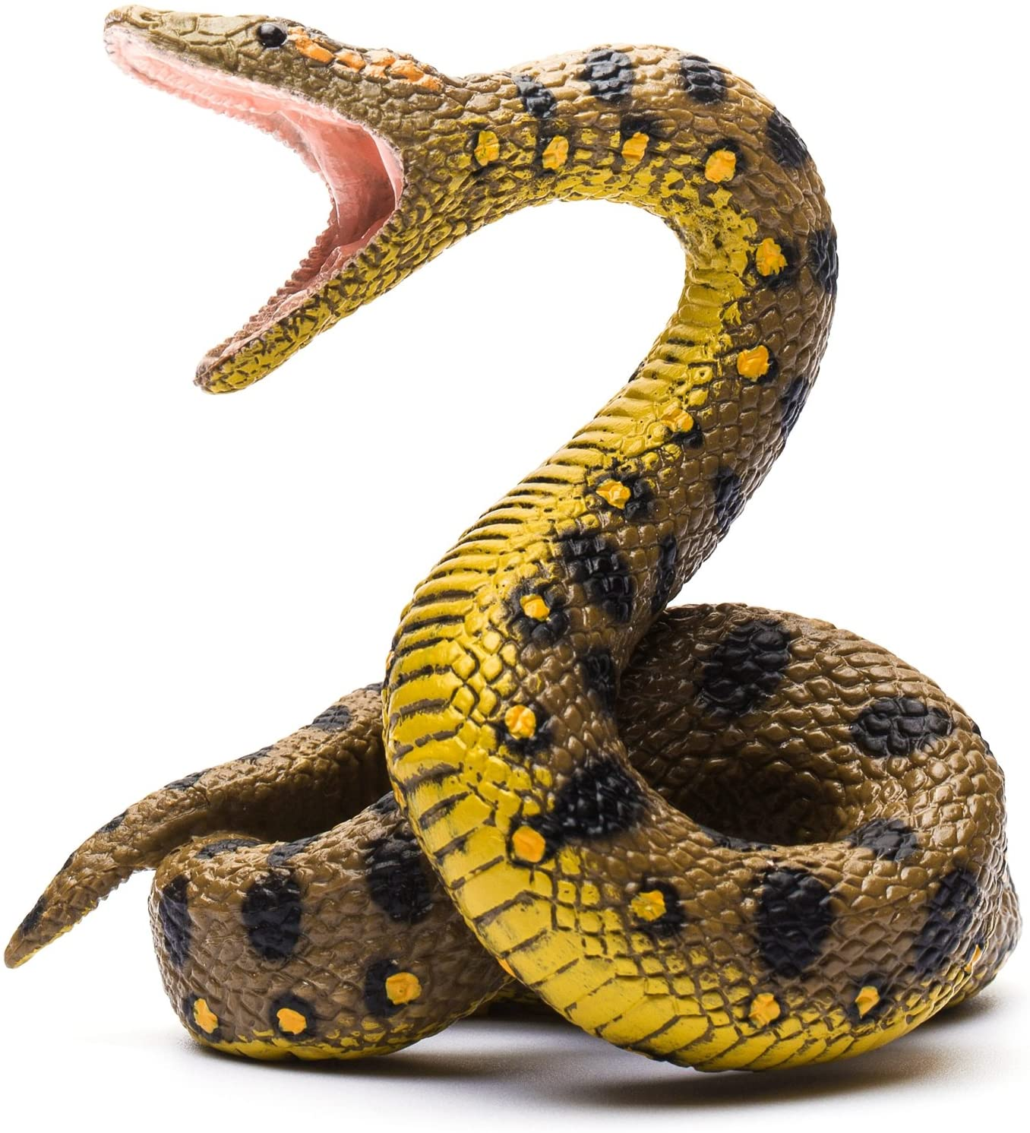
First steps …
Let’s discuss Anaconda- The World's Most Popular Data Science Platform
Anaconda is not Python
An environment for developing Python and R projects
Optimized for data science

Slide 3

Go to anaconda.com

Slide 4
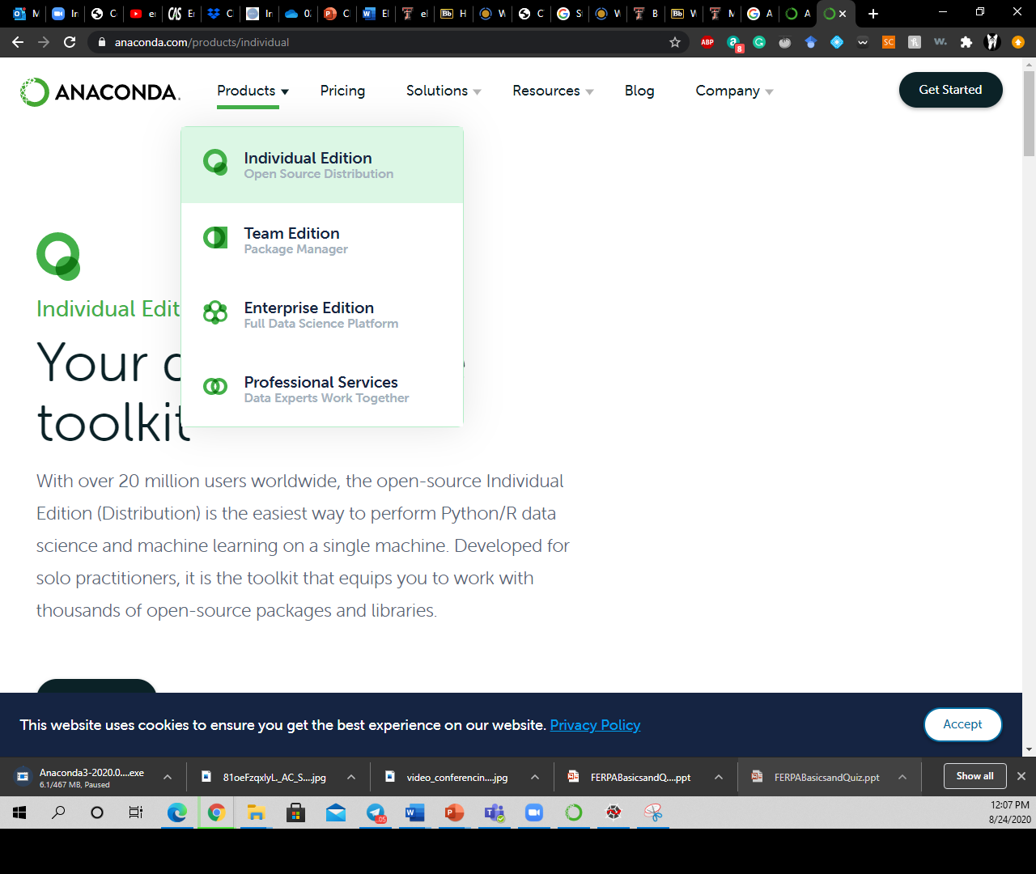
1. Click on “Products”
2. Choose “Individual Edition”

Slide 5
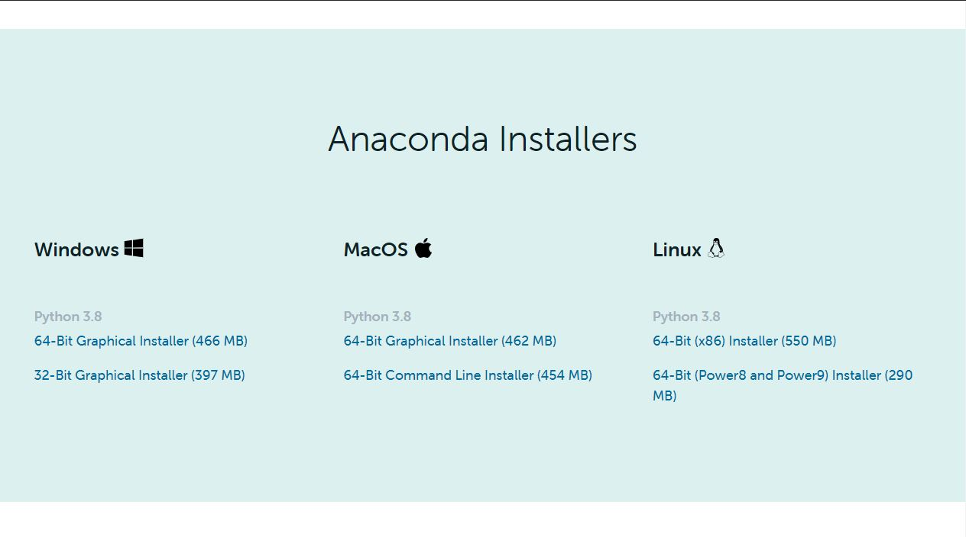
Choose the right version and download it

Slide 6

It will take a while …

Slide 7
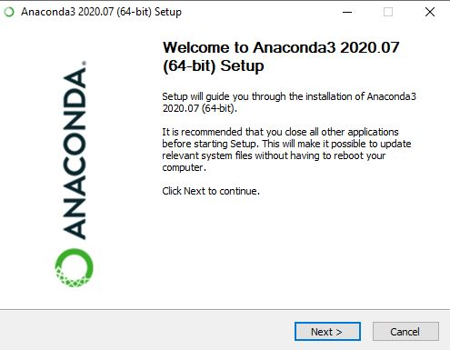
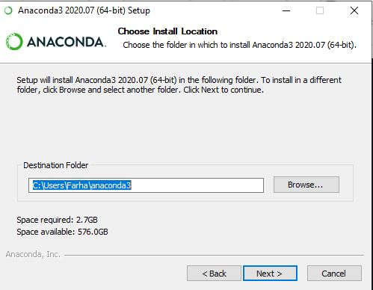
Anaconda requires almost 3 GB of free space
Install it in a separate folder
Preferably on a drive with lots of free memory!
It will take a while !

Slide 8
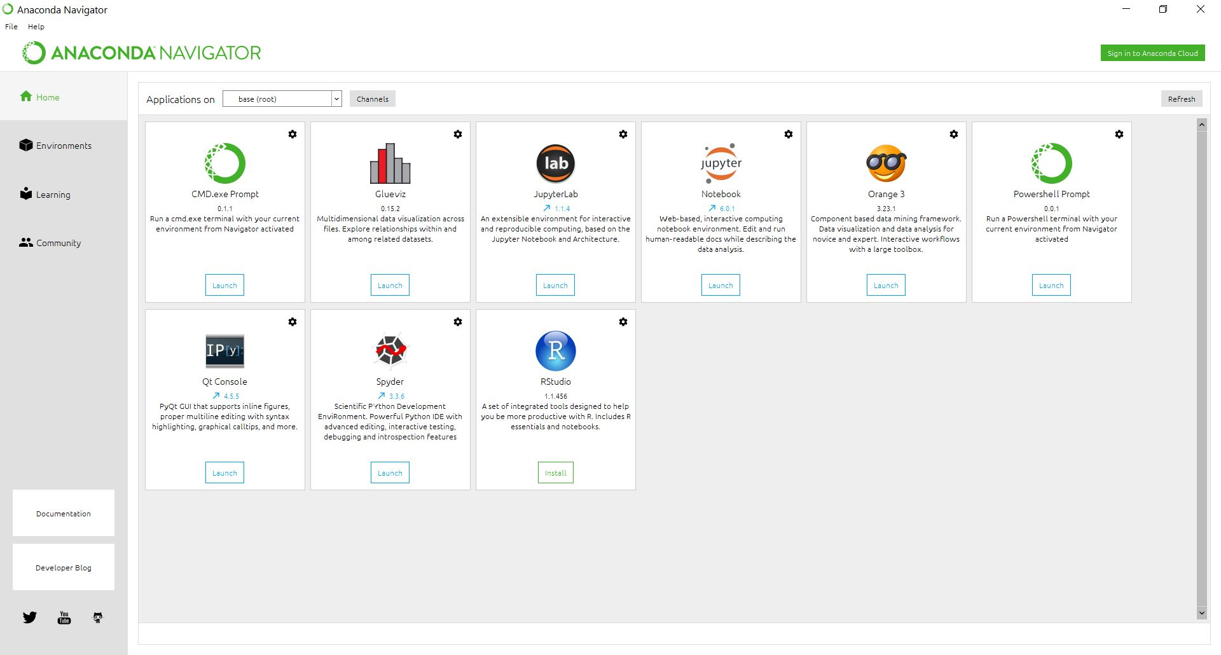
Anaconda Navigator brings together several applications
They can also be run separately

Slide 9
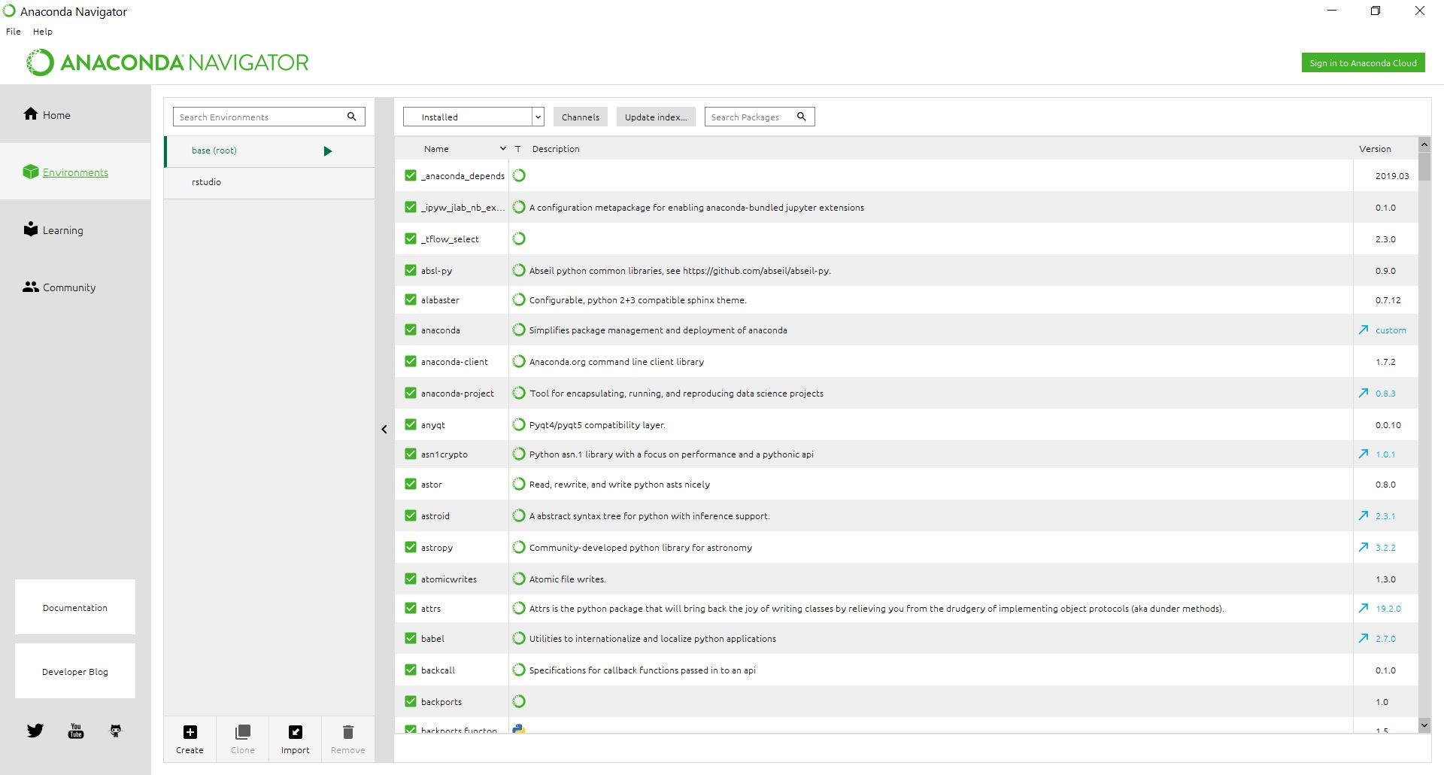
Anaconda Navigator allows the installation, removal, or updating of packages and environment set-ups

Slide 10
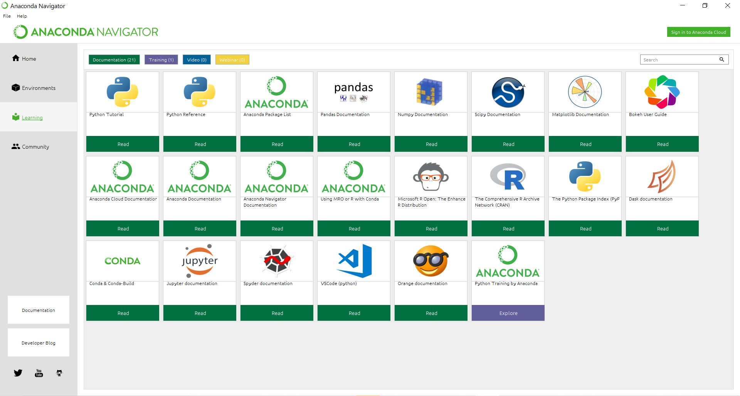
Various useful learning modules under the “Learning” tab

Slide 11
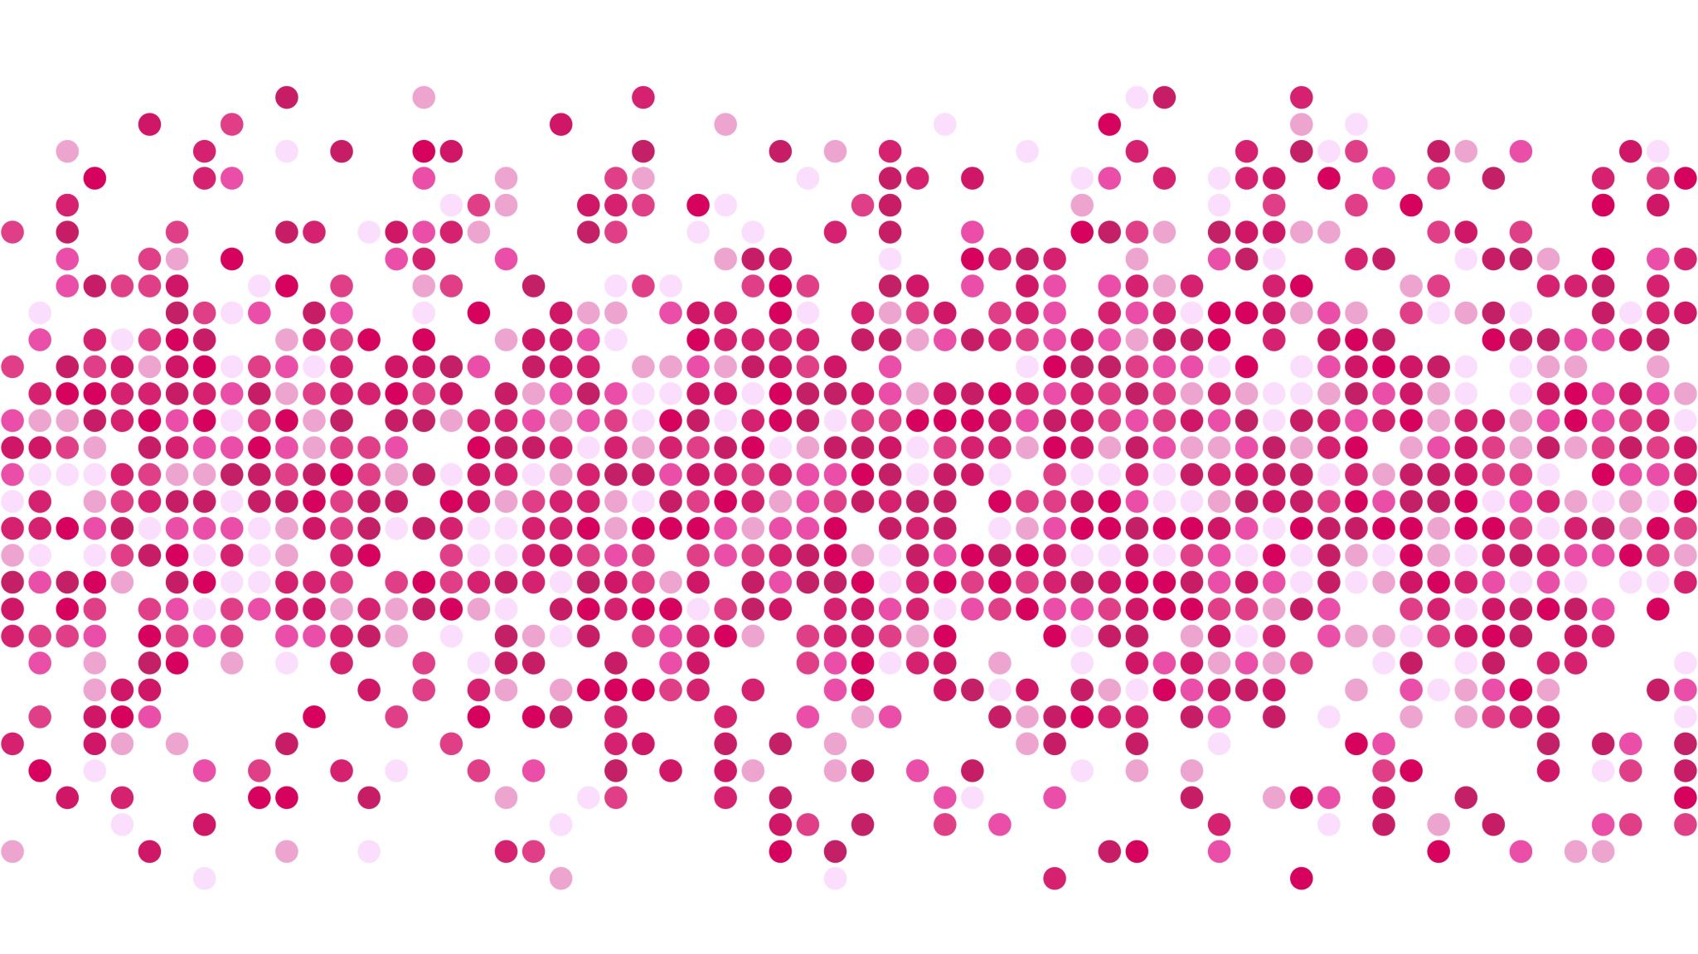
Thank you for your attention…

